Slide 1
Common eelgrass epifauna near Calvert, and a few patterns across time and space

Slide 2
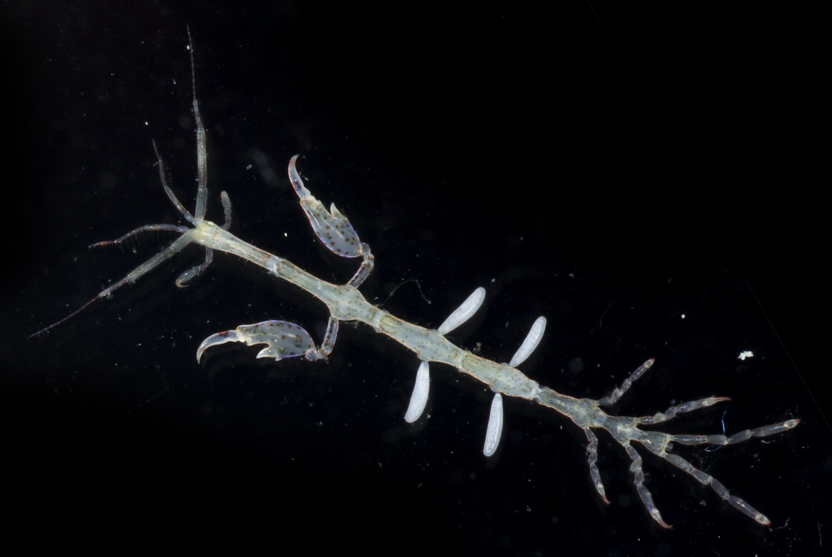
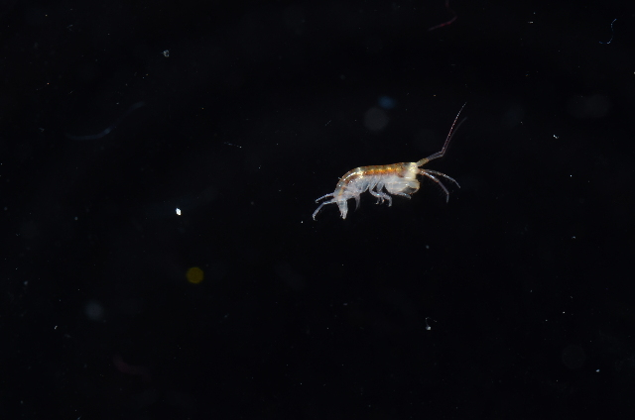
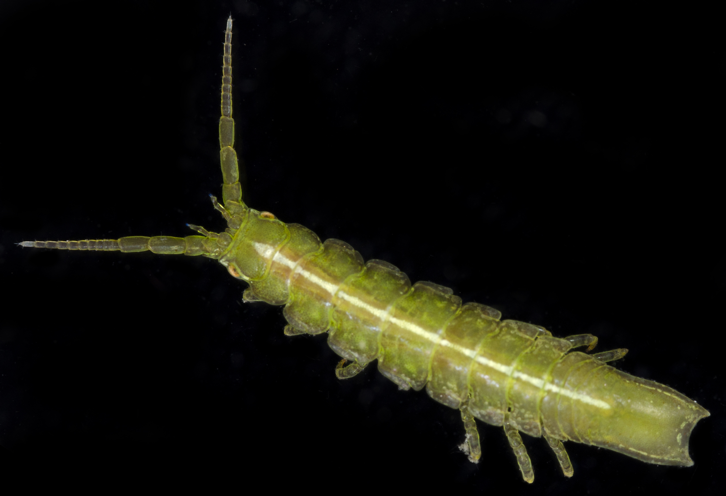
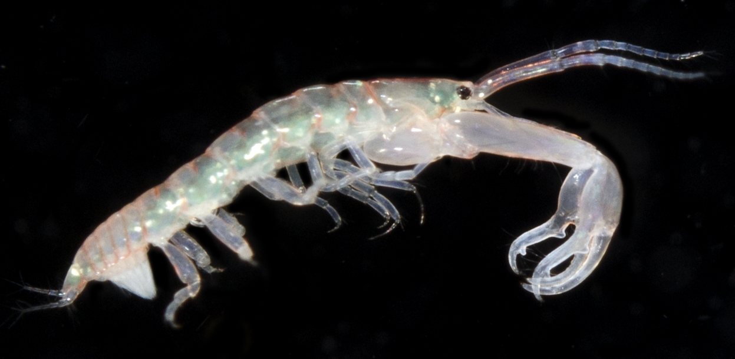
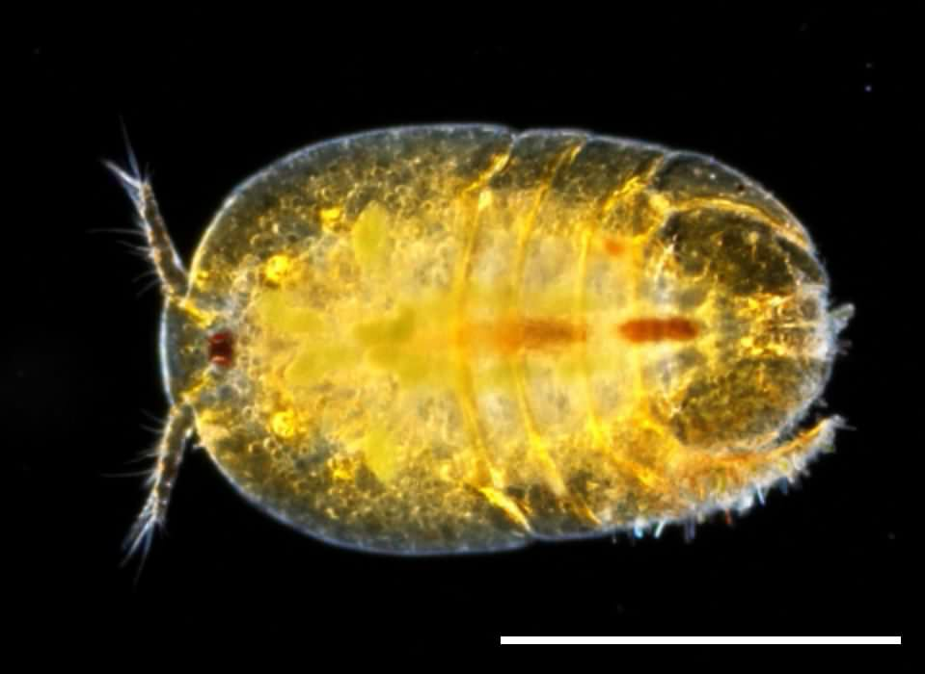
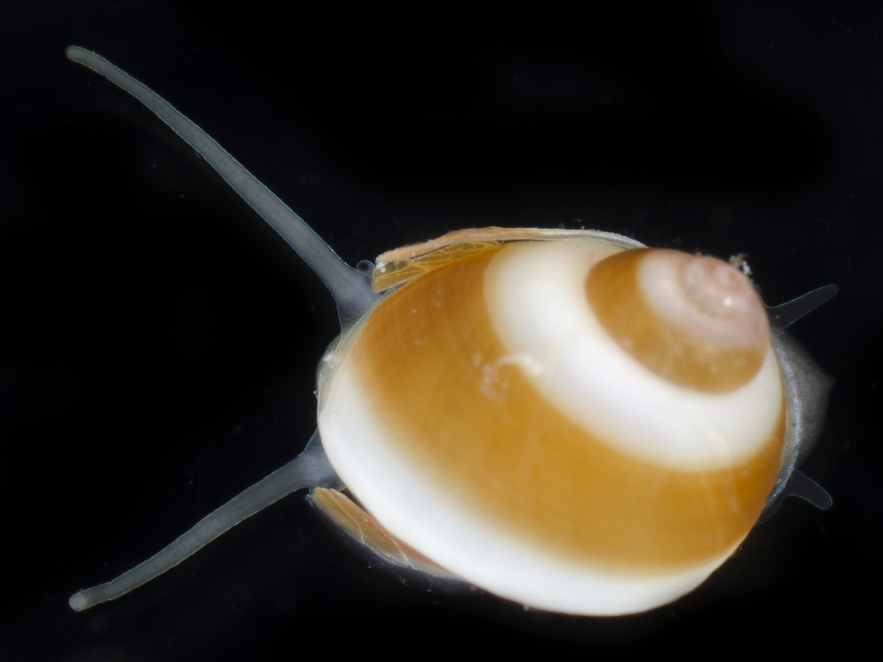
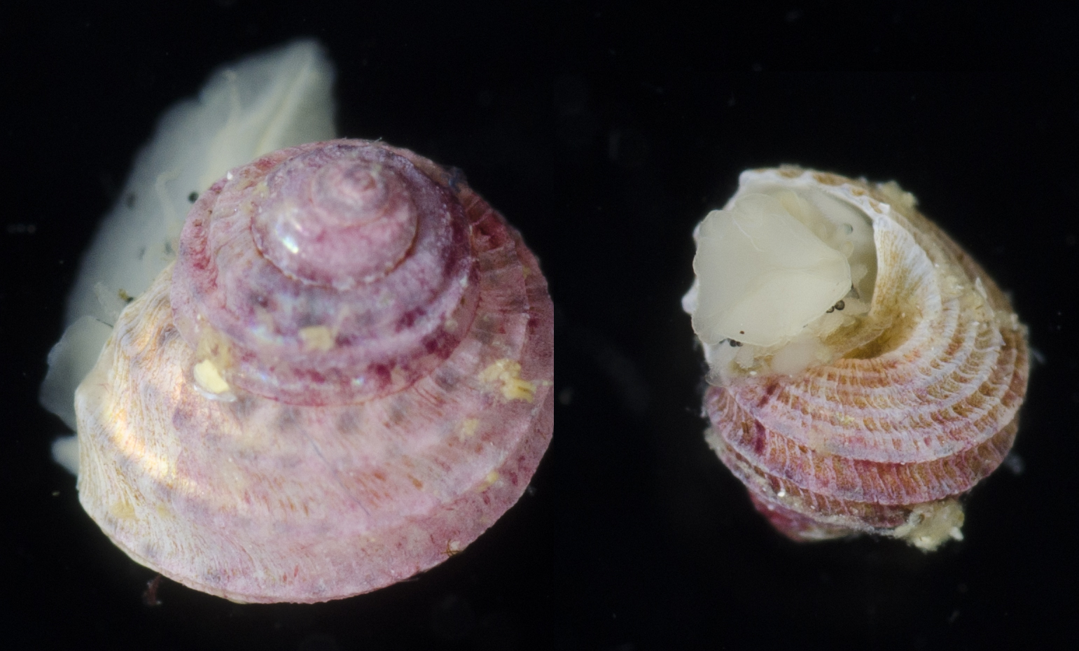
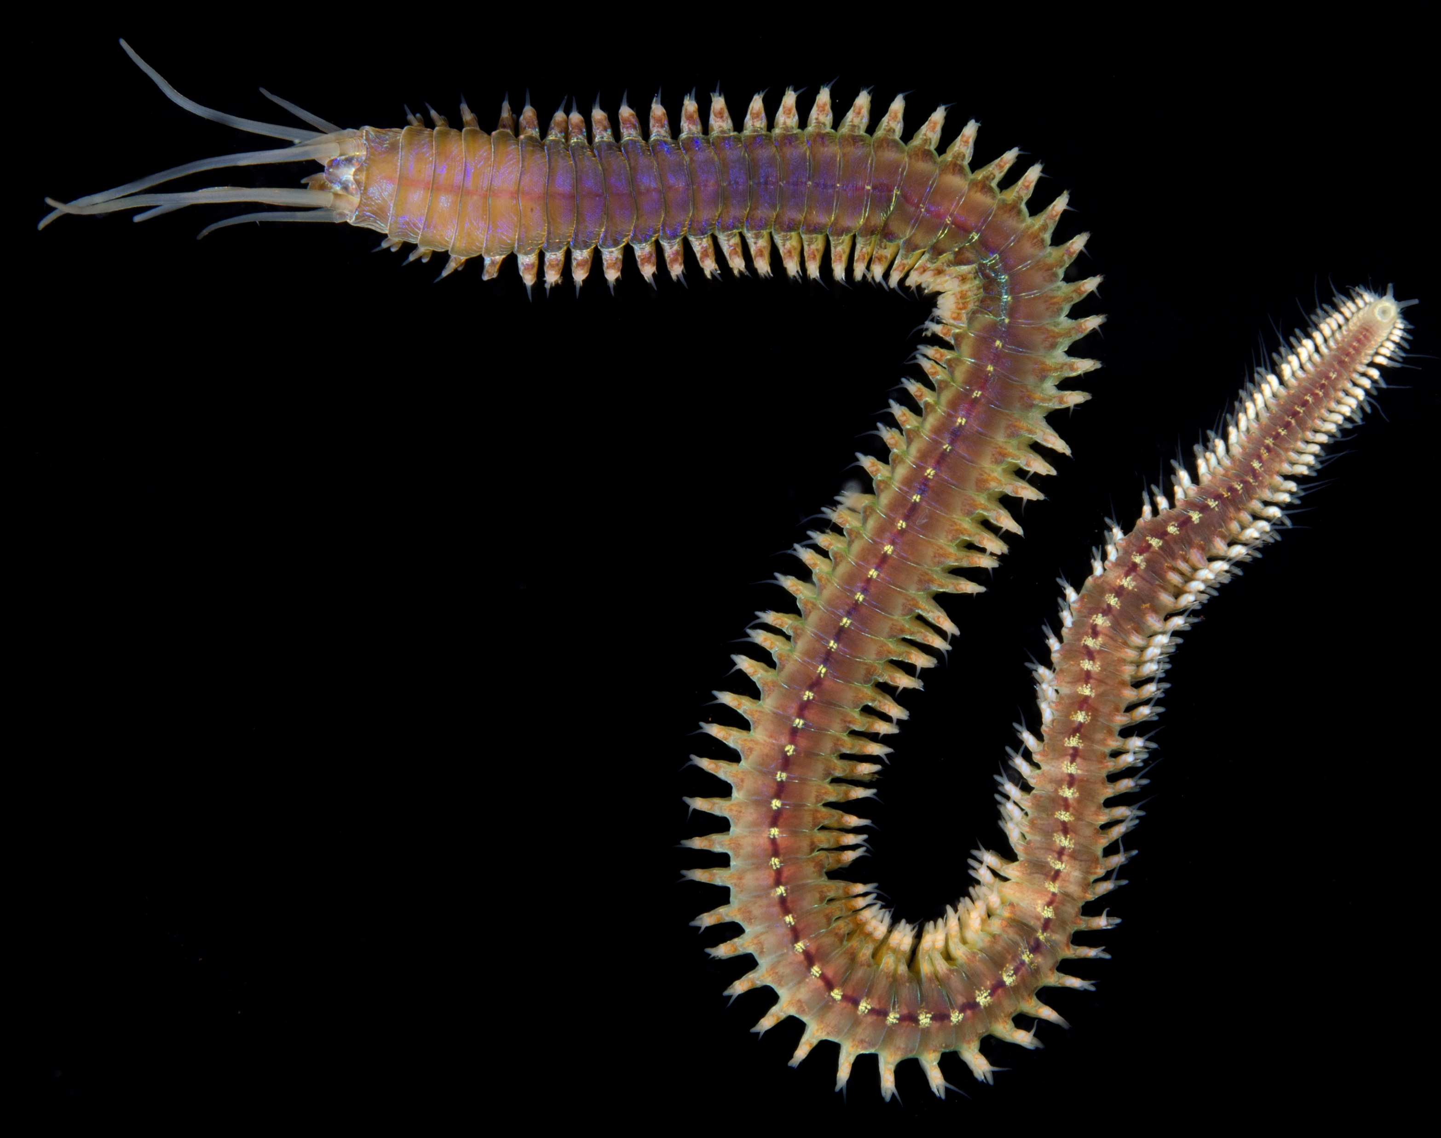
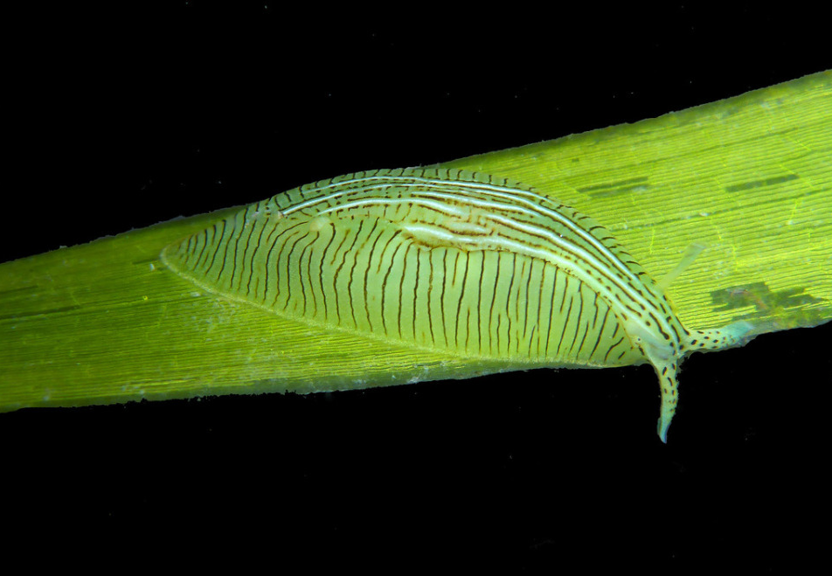
Crustaceans
“gammaridean”
Isopoda
Caprellidae
Tanaidacea
Harpacticod copepods
Peracarids
Polychaetes
Mollusks
Phyllodocida
includes nererids, phyllodocids, syllids, glycerids, hesionids, polynoids
Trochoidea
Littorinoidea
Phyllaplysia
no planktonic form
planktonic larvae

Slide 3

2014
2015
2016
2017

Slide 5
Rank-abundance curves for lumped taxa from 4 core sites

Slide 6
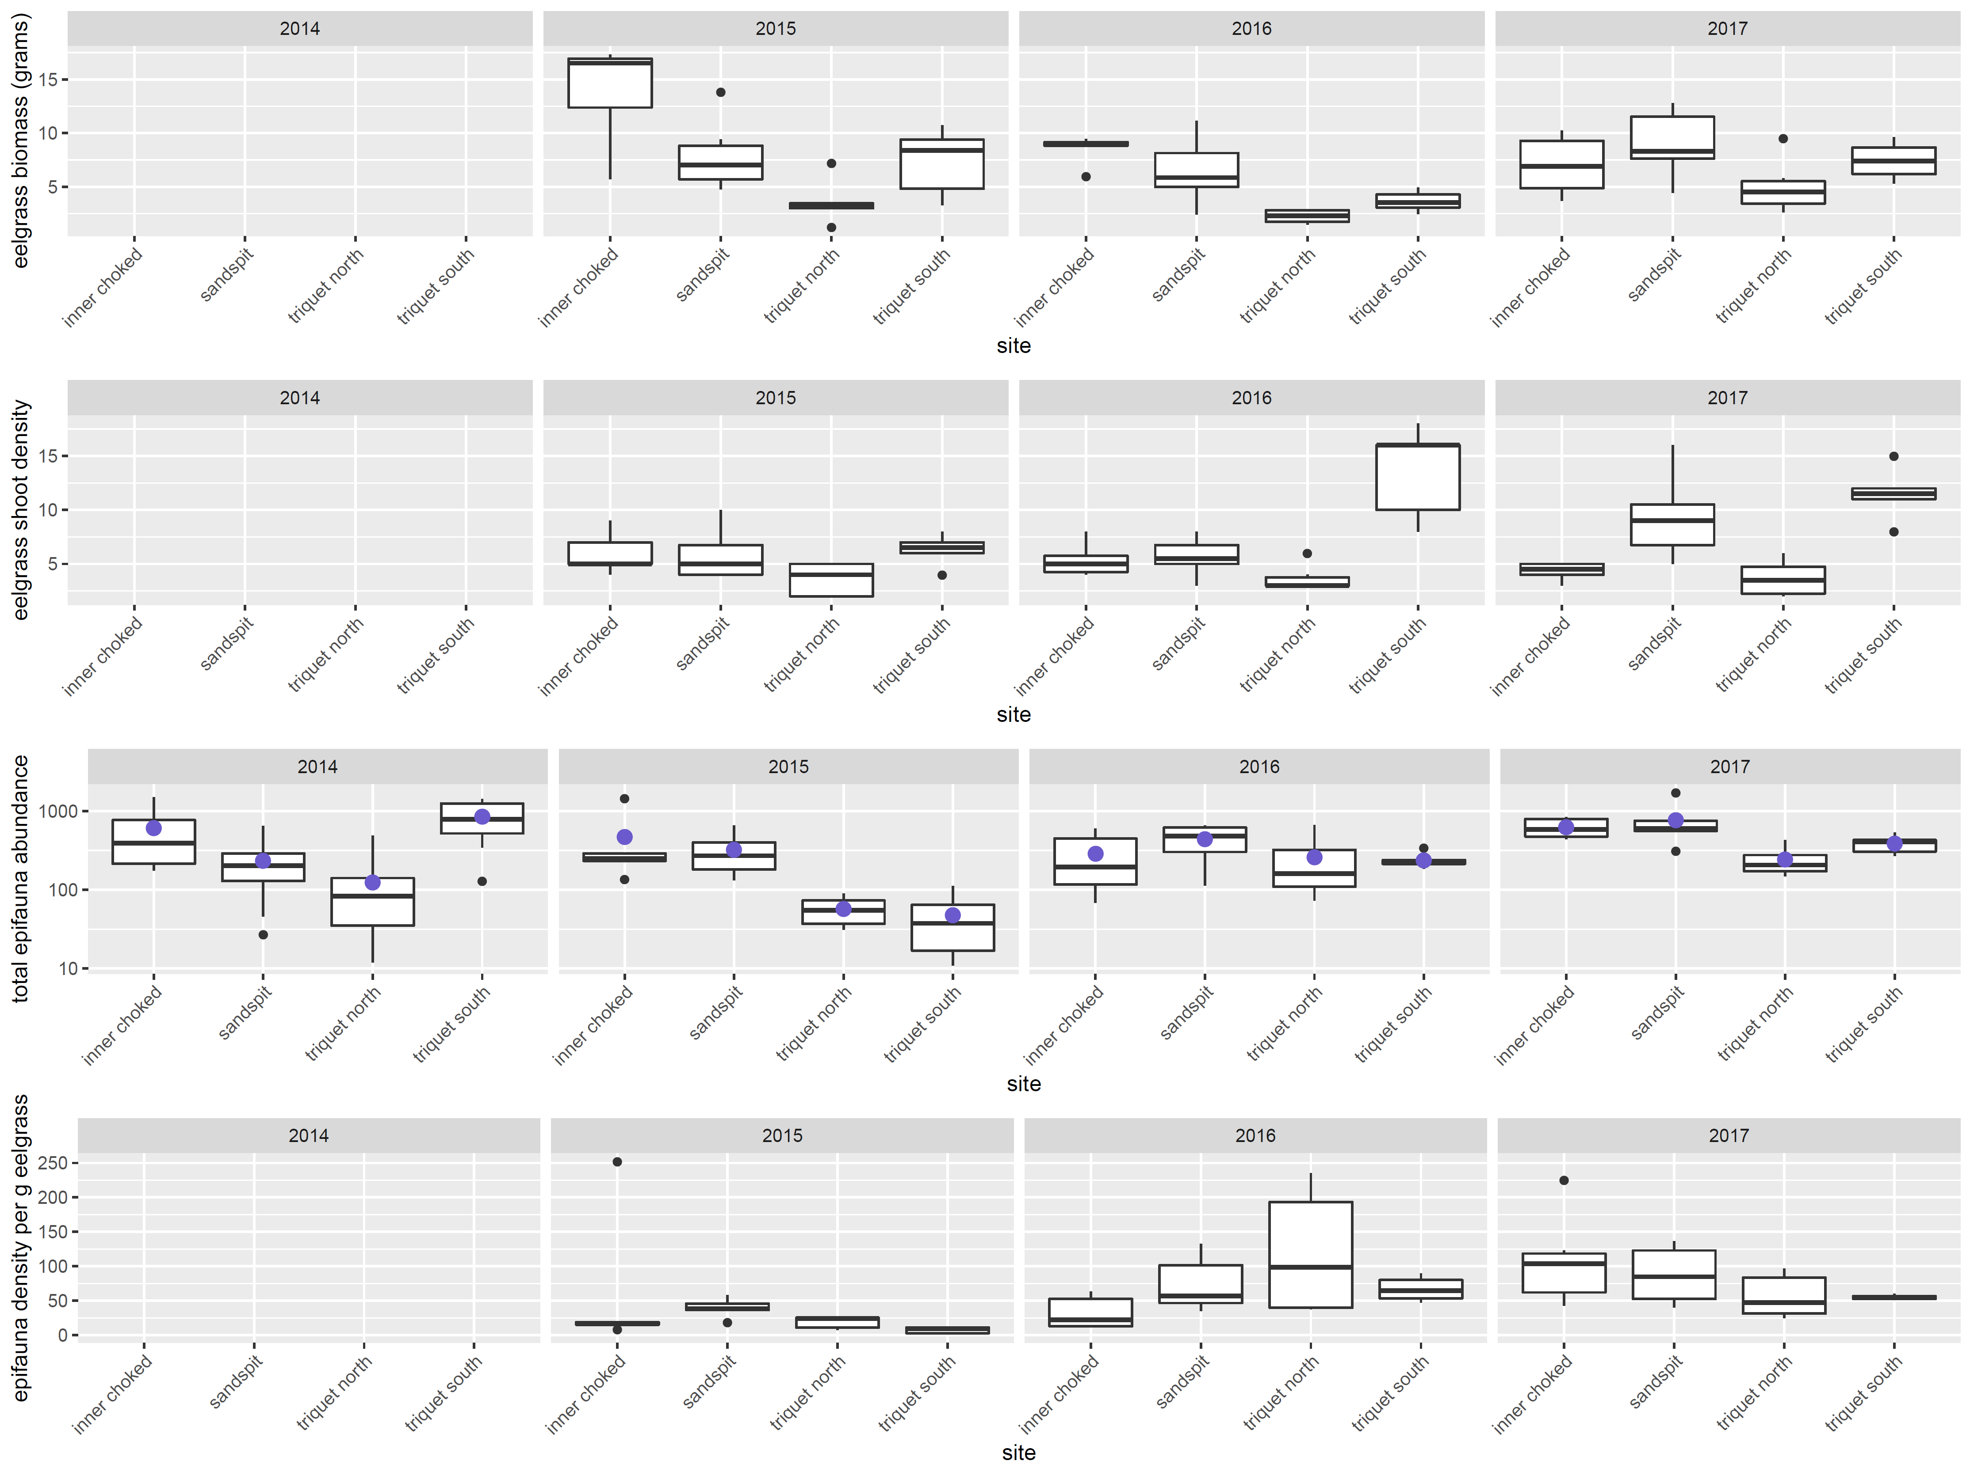
Eelgrass and epifauna summaries from 4 core sites

Slide 7
Epifauna alpha diversity indices from 4 core sites

Slide 8
Epifaunal communities from Calvert are distinct from Triquet
Epifaunal communities differ across years

